Slide 1
Addition and Subtraction of Vector
Presented By Jamil Rayhan
ID: 18CSE061

Slide 2
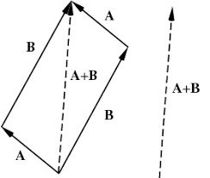
Vector Addition
Vector addition is the operation of adding two or more vectors together into a vector sum.
The so-called parallelogram law gives the rule for vector addition of two or more vectors.

Slide 3
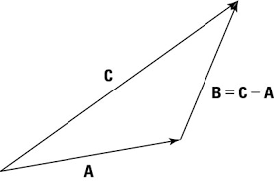
Vector subtraction
Vector subtraction is the process of taking a vector difference,
Inverse operation to vector addition.

Slide 4
Adding and Subtracting Vectors
Add or subtract the corresponding components.
Let u =⟨u1,u2⟩ and v =⟨v1,v2⟩ be two vectors.
Then, the sum of u and v is the vector
u + v =⟨u1+v1,u2+v2⟩

Slide 5
Adding and Subtracting Vectors(cont.)
The difference of u and v is
u − v = u + ( −v )
=⟨u1−v1,u2−v2⟩ u − v = u + ( −v )
=⟨u1−v1,u2−v2⟩
The sum of two or more vectors is called the resultant. The resultant of two vectors can be found using either the parallelogram method or the triangle method .

Slide 6
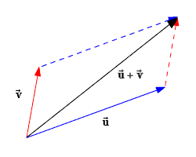
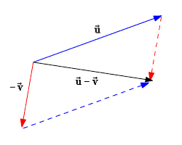
Parallelogram Method Place both vectors u and v at the same initial point. Complete the parallelogram. The resultant vector u + v is the diagonal of the parallelogram.
Draw the vectors so that their initial points coincide. Then draw lines to form a complete parallelogram. The diagonal from the initial point to the opposite vertex of the parallelogram is the resultant.

Slide 7
Parallelogram Vector Addition
Place both vectors u⃗ u→ and v⃗ v→ at the same initial point.
Complete the parallelogram. The resultant vector u⃗ +v⃗ u→+v→ is the diagonal of the parallelogram.

Slide 8
Triangle Method:
Draw the vectors one after another, placing the initial point of each successive vector at the terminal point of the previous vector. Then draw the resultant from the initial point of the first vector to the terminal point of the last vector. This method is also called the head-to-tail method .

Slide 9
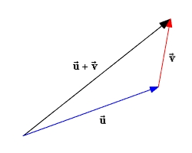
Triangle Addition Method:

Slide 10
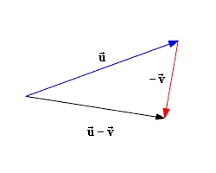
Triangle Subtraction Method:

Slide 11
Example:
Find (a) u⃗ +v⃗ u→+v→ and (b) u⃗ −v⃗ u→−v→ if u⃗ =⟨3,4⟩u→=⟨3,4⟩ and v⃗ =⟨5,−1⟩v→=⟨5,−1⟩ .
Substitute the given values of u1u1 , u2u2 , v1v1 and v2v2 into the definition of vector addition.
u⃗ +v⃗ =⟨u1+v1,u2+v2⟩ =⟨3+5,4+(−1)⟩ =⟨8,3⟩

Slide 12
Rewrite the difference u⃗ −v⃗ u→−v→ as a sum u⃗ +(−v⃗ )u→+(−v→) . We will need to determine the components of −v⃗ −v→ .
Recall that −v⃗ −v→ is a scalar multiple of −1−1 times vv . From the definition of scalar multiplication, we have:
−v⃗ =−1⟨v1,v2⟩ =−1⟨5,−1⟩ =⟨−5,1⟩−v→=−1⟨v1,v2⟩ =−1⟨5,−1⟩ =⟨−5,1⟩
Now add the components of u⃗ u→ and −v⃗ −v→ .
u⃗ +(−v⃗ )=⟨3+(−5),4+1⟩ =⟨−2,5⟩

Slide 13
Thank You...

